Slide 1
Rover PDR
Team Name
Team Number

Slide 2
Presentation Outline
Provide a simple outline of the presentation
Indicate team member(s) who will present each section

Slide 3
Team Organization
Single slide listing team members and role
Can use an organization chart

Slide 4
Acronyms
Provide a list of acronyms used throughout the presentation
Used as reference only. Does not need to be read through

Slide 5
Systems Overview
Presenter name here

Slide 6
Mission Summary
Overview of mission objectives
Include any external objectives

Slide 7
System Requirement Summary
Overview of system (mission) level requirements
Use bullets or table to demonstrate understanding of requirements
Include requirements for the rover
Include requirements for the rocket
Partial sample of what the table might look like
Requirement | Plan for compliance
Container and Rover < 2kg | Design for low mass and choose low mass components
Ascend to 1000-2000 feet | Size rocket appropriately for total mass
Container shall descend at <15 feet/sec | Size parachute accordingly

Slide 8
System Level Concept Trade and Selection
Present preliminary system-level design concepts which were considered
Overall design concepts
Configurations of rocket and rover
Teams can break up into small groups and come up with independent design concepts
Show at least 2 different concepts
Present criteria for final configuration selection
Include sketches and diagrams of various concepts considered.
Include variations on CONOPS considered
See Trade Studies Slide at end of slides

Slide 9
System Concept of Operations (CONOPS)
Provide overview of operations of the system from launch to landing to rover operations.
Launch and descent operations
Rover operations
Post-launch recovery
Simple flow diagrams and cartoons are a good way to present the CONOPS
See Example Concept of Operations at end of slides

Slide 10
Rocket Design
Presenter Name

Slide 11
Design of Rocket
Describe overall rocket design
A drawing of the rocket identifying all of its components and dimensions
Length and diameter
Identify major components and locations
Nose cone
Number of fins and size
Location and size of rail buttons
Location of avionics bay if using electronics deployment with altimeter(s)
Total on the pad weight of the rocket with the primary and backup motors.
This includes:
All recovery harnesses and parachutes
Primary or backup motor
Rover

Slide 12
Design of Rocket (continued)
Identify the rocket’s stability. The center of gravity (CG) must be ahead of the center of pressure (CP) by at least one diameter (caliber) of your rocket.
With primary motor
With backup motor
Motor retention method
Friction fit is specifically disallowed
Explain how the rover is stowed and deployed from rocket

Slide 13
Rocket Materials
List of materials used:
Airframe material
Fin material
Nose cone material
Type of adhesives used
Rail button source and material

Slide 14
Rocket Recovery System
Parachute selection
Size of and how determined
Identify method for protecting parachute and rationale for choice
Dual deploy?
What is the expected descent rate(s)
Harness
Show drawing of recovery harnesses for each part of rocket
Type of shock cord, lengths and strengths
Identify linkages and load limits
Attachment points, eyebolts, fender washers, etc. and their mounting methods

Slide 15
Rocket Recovery System Deployment Method
Document method of initiating recovery
Altimeter(s)
Parachute release mechanism
Motor ejection - specify motor delay in seconds for
Primary motor
Secondary motor
Any rockets using VMAX motors must use an altimeter that deploys the parachutes as per Tripoli and NAR rules.

Slide 16
Rocket Recovery Electronics - if used
Identify which commercial altimeter(s) will be used
Show wiring diagram of altimeters with charges
Document the number and size of the pressure ports for altimeter
Document altimeter preparation steps.
Specify the quantity of black powder to be used to separate each section
Specify the volume of the section to be pressurized with calculated pressure level
Document charge size testing and results
Specify how sections are secured before the ejection charges separate sections
friction fit
shear pins - number and size
Other
Identify how charges are fired
e-matches
other

Slide 17
Altitude Recording Altimeter
Identify the commercial altimeter to be used to officially record the rocket’s altitude
If using a commercial altimeter for deployment, it can be designated the altitude recording altimeter

Slide 18
Rocket Motor Selection
Identify primary motor selection
Calculate thrust to on pad weight ratio using average thrust of the primary motor
Thrust to weight ratio must be a minimum of 5:1
Identify back up motor selection and what changes to rocket would be required to successfully comply with contest rules
Calculate thrust to on pad weight ratio using average thrust of the backup motor
Thrust to weight ratio must be a minimum of 5:1
Include a simulation plot for the primary motor
Include a simulation plot for the backup motor

Slide 19
Mars Rover Design

Slide 20
Mars Rover Design Overview
Show diagram or picture of payload design concept
Identify major components
Provide Dimensions

Slide 21
Rover Design
Show at least two rover design concepts
Identify mechanisms used, example wheels, servos, solenoids, hinges, springs, etc
Explain and show how the rover navigates either autonomously or by command
Indicate design selection and reason
See Trade Studies Slide at end of slides

Slide 22
Rover Container Mechanical Trade
Mechanical design description of container
Structure
Component placement, electronics, actuators, etc.
Show two design concepts
How is rover protected
Indicate design selection and rationale
See Trade Studies Slide at end of slides

Slide 23
Container Descent Control at 15 ft/s
Show and explain two designs for controlling the container descent at 15 ft/s
Material selections
Colors
Attachment method
See Trade Studies Slide at end of slides

Slide 24
Rover Soil Collection Design
Show and explain mechanism for collecting soil sample
Show and explain how the sample is stored
Identify mechanisms and structures used
Show how collection device is stowed during flight
Show at least 2 concepts and your reasons for selection
See Trade Studies Slide at end of slides

Slide 25
Rover and Container Mass Budget
Show mass of all components of the selected rover and container design
Mass of each structural element in grams
Sources/uncertainties – whether the masses are estimates, from data sheets, measured values, etc.
Total mass of all components and structural elements
Margin: The amount of mass (in grams) in which the mass budget meets, exceeds, or falls short of the mass requirement

Slide 26
Rover Electronics

Slide 27
Rover Electronics Block Diagram
Show block diagram of electronics
Identify processor, sensors, mechanism control circuits, radio, etc.

Slide 28
Rover Processor and Memory
Do a trade study on processors and memory required for the rover
Include
Processor speed and data width
Data interfaces
Memory storage requirements
Boot time
Show at least two choices
Indicate selection and rationale
See Trade Studies Slide at end of slides

Slide 29
Rover Sensors & Camera
Do a trade study on sensors required to navigate the rover
Include
Types of sensors to provide required telemetry
Specifications of sensors
Power requirements
Show at least two choices
Indicate selection and rationale
Do a trade study on cameras required for the rover
Include
Specifications of cameras
Power requirements
Show at least two choices
Indicate selection and rationale
One page per component
See Trade Studies Slide at end of slides

Slide 30
Container Electronics Block Diagram
Show block diagram of electronics
Identify processor, sensors, mechanism control circuits, radio, etc.

Slide 31
Container Processor and Memory
Do a trade study on processors and memory required for the rover
Include
Processor speed and data width
Data interfaces
Memory storage requirements
Boot time
Show at least two choices
Indicate selection and rationale
See Trade Studies Slide at end of slides

Slide 32
Container Sensors
Do a trade study on sensors required for the payload
Include
Types of sensors to provide required telemetry
Specifications of sensors
Power requirements
Show at least two choices
Indicate selection and rationale
One page per sensor
See Trade Studies Slide at end of slides

Slide 33
Container Telemetry Radio Trade
Do trade selection of at least two types of radio systems for the Container to Ground Station Radio
Type of radio
Frequency
Power level
See Trade Studies Slide at end of slides

Slide 34
Container Telemetry Antenna Trade
Do trade selection of antennas for the telemetry link to the ground station
Type antenna
Antenna pattern
See Trade Studies Slide at end of slides

Slide 35
Rover Command Radio Trade
Do trade selection of at least two types of radio systems for the Rover Command Radio
Type of radio
Frequency
Power level
See Trade Studies Slide at end of slides

Slide 36
Rover Command Antenna Trade
Do trade selection of antennas for the telemetry link to the ground station
Type antenna
Antenna pattern
See Trade Studies Slide at end of slides

Slide 37
Rover Power Trade
Trade study of battery types and configurations
Battery configuration (series/parallel/other)
Power capacity
Mounting method
Protection circuits
Short circuit
Over-discharge for lithium ion cells
See Trade Studies Slide at end of slides

Slide 38
Rover Power Budget
Power sources considered
List power consumption of all electrical components
All values are to be in watt-hours
Compare to capacity of battery in watt-hours
Identify how long rover can operate on batteries

Slide 39
Container Power Trade
Trade study of battery types and configurations
Battery configuration (series/parallel/other)
Power capacity
Mounting method
Protection circuits
Short circuit
Over-discharge for lithium ion cells
See Trade Studies Slide at end of slides

Slide 40
Container Power Budget
Power sources considered
List power consumption of all electrical components
All values are to be in watt-hours
Compare to capacity of battery in watt-hours
Identify how long container can operate on batteries

Slide 41
Rover Software Design
Software development environment, and plan
Flow Chart of software
Identify software states and how software transitions to each state
Power up
Integration
Launch
Deployment
Landing
Ground operation
Commanding

Slide 42
Rover Software Development Plan
Describe plan for software development
Include
Prototyping and prototyping environments
Software subsystem development sequence
Development team
Test methodology

Slide 43
Container Software Design
Software development environment, and plan
Flow Chart of software
Identify software states and how software transitions to each state
Power up
Integration
Launch
Deployment
Landing
Ground operation
Commanding

Slide 44
Container Software Development Plan
Describe plan for software development
Include
Prototyping and prototyping environments
Software subsystem development sequence
Development team
Test methodology

Slide 45
Rover Integration
Describe process to integrate rover into container.
What needs to be disassembled
How is rover secured
How is container prepared for launch
How container is integrated into the rocket

Slide 46
Ground Station Description
Design of ground station for collecting telemetry from container
Show Block diagram and identify components
See Trade Studies Slide at end of slides

Slide 47
Ground Station Radio Trade
Do trade selection of at least two types of radio systems used to receive telemetry from the cannister
Type of radio
Frequency
Power level
See Trade Studies Slide at end of slides

Slide 48
Ground Station Antenna Trade
Do trade selection of antennas
Type antenna
Antenna pattern
See Trade Studies Slide at end of slides

Slide 49
Ground Station Software
Describe software development environment
Software flow chart

Slide 50
Rover Controller
Show design of rover controller
Include a block diagram

Slide 51
Rover Controller Radio Trade
Do trade selection of at least two types of radio systems sending commands to rover
Type of radio
Frequency
Power level
See Trade Studies Slide at end of slides

Slide 52
Rover Controller Antenna Trade
Do trade selection of antennas
Type antenna
Antenna pattern
See Trade Studies Slide at end of slides

Slide 53
Rover Controller Software
Describe software development environment
Software flow chart

Slide 54
Testing

Slide 55
Payload Testing
Describe testing of payload subsystems
Describe testing during subsystem integration
Describe functional testing of completed payload
Describe testing to determine if payload will survive deployment and landing

Slide 56
Rocket Testing
Describe testing of rocket
Parachute deployment testing
Payload deployment testing
Flight test

Slide 57
Flight Operations
Describe procedures during launch day
Rocket preparation
Container and rover preparation
Container integration into rocket
Preparations at the launch pad
Lander arming process

Slide 58
Program Schedule
Show a Gantt chart schedule of the complete development cycle up to contest date
Component and service schedule
When components are bought and lead times for components
Services required (contract machining, PCB, etc.)

Slide 59
Program Budget
Show budget for all parts of the program
Components
Split out rocket and rover into separate tables
Services
Travel expenses

Slide 60
Summary
Describe state of development efforts, any accomplishments, issues, and way forward

Slide 61
Instructions
Slides are a template describing information needed.
Each section can be expanded into more slides as needed. Don't try cramming each listed topic on the same slide.
Place team/school logo in the top left corner.
Put page numbers on the slides.
Formatting and background can be customized. This document is distributed as PDF to force you to make your own.
Do not include animations or videos as reviewers may not have compatible software.
Submit PDR in pdf format for maximum compatibility.
Do not include this slide in the presentation. Yes, some one will.

Slide 62
Trade Studies
Recommendations for trade studies:
Tabular format
Discuss criteria for selection
Studied configurations
Assessment criteria and ranking
Be clear on final component/configuration selections
When using hardware from previous years, do the same
Be consistent with trade study presentations
 | Complexity | Mass | Cost | Etc
Design #1 - selected | Simpler | higher mass | Lower cost
Design #2 | More complex | lower mass | Higher cost
Example of a table you might use to show your trade results

Slide 63
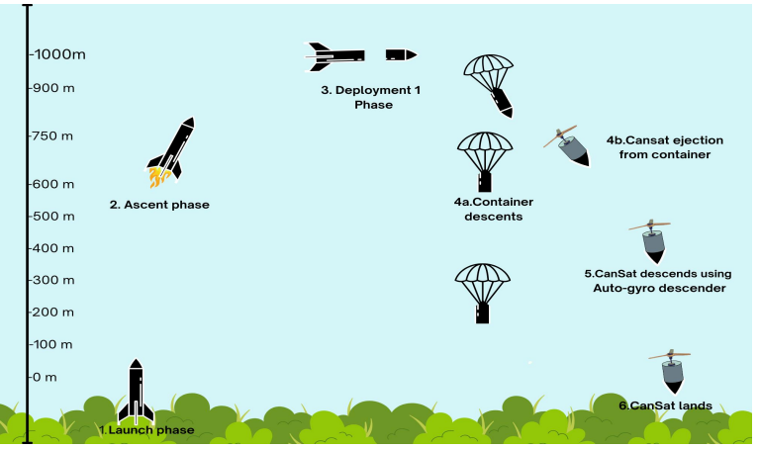
Example Concept of Operations (1 of 2)
From a different competition

Slide 64
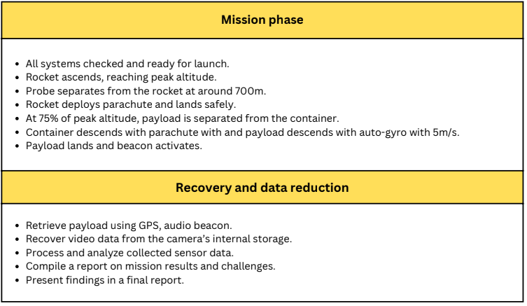
Example Concept of Operations (2 of 2)
From a different competition

